Slide 1
Keesler Air Force Base
84th Anniversary
Mr. Tyrone D. Scott
81st Training Wing History Office
tyrone.scott@us.af.mil
Commercial: 228-377-1348
DSN: 312-597-1348

Slide 2
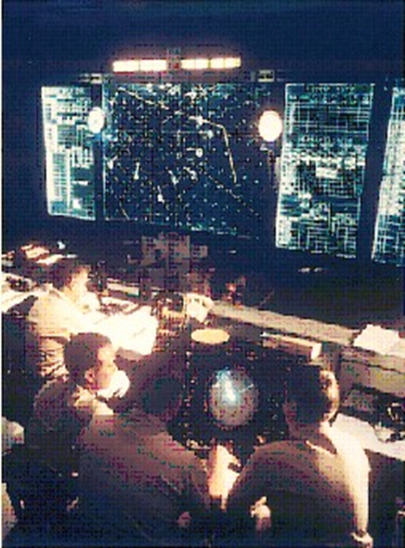
Keesler AFB History
Advances in evolving technology rapidly led to changes in Keesler’s training.
Keesler Air Force Base (KAFB) has it established itself as an exemplary installation for 84 years.
KAFB has a proud heritage of providing technical training to American War-Fighters.
The installation offered lucrative career opportunities to women and minorities even during Jim Crow segregation as our nation fought World War II, the Korean War, and the Vietnam War.
Keesler still sets the high standard with outstanding cyber courses to “train, develop, and inspire warfighters.”

Slide 3

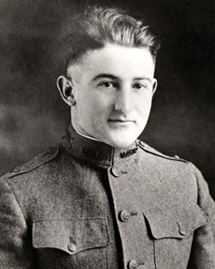
Keesler AFB History
Second Lieutenant Samuel Reeves Keesler, Jr.
A Fine American Airman
1896 – 1918
Born in Greenwood, Mississippi 11 April 1896
Entered the U.S. Army Air Service on 13 May 1917 during WWI
Aerial Observer and Aerial Gunnery and Artillery Fire Control
Assigned to the 24th Aero Squadron, Verdun sector of the Western Front in France, 26 August 1918
Seriously wounded during the battle and ensuing crash landing 8 October 1918
Captured by enemy (German) soldiers the same day
Succumbed to his injuries 9 October 1918 after not receiving medical care
Posthumously awarded the WWI Victory Medal with Silver Star device for his gallantry.

Slide 4
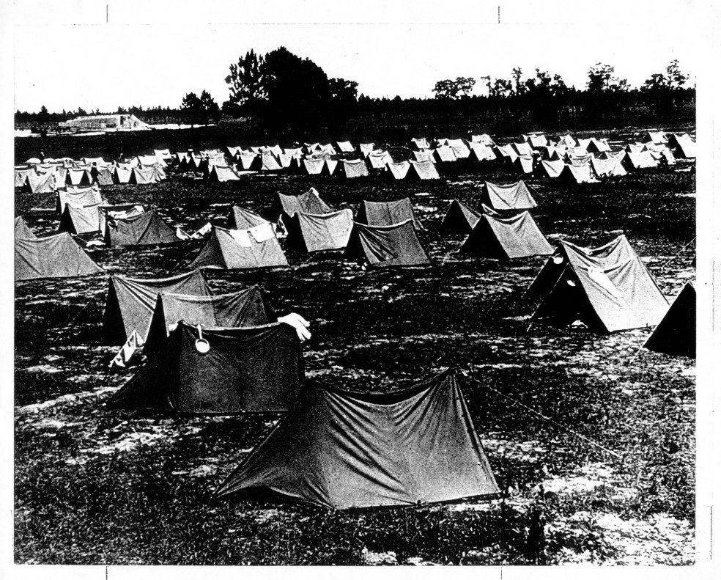
Keesler AFB History
Tent quarters, circa April 1941, in the former Naval Reserve Park
Biloxi city officials asked U.S. Army Corps to build a base to support the WWII training buildup in January 1941.
Offer included the Biloxi airport, the old Naval Reserve Park, and parts of Oak Park

Slide 5
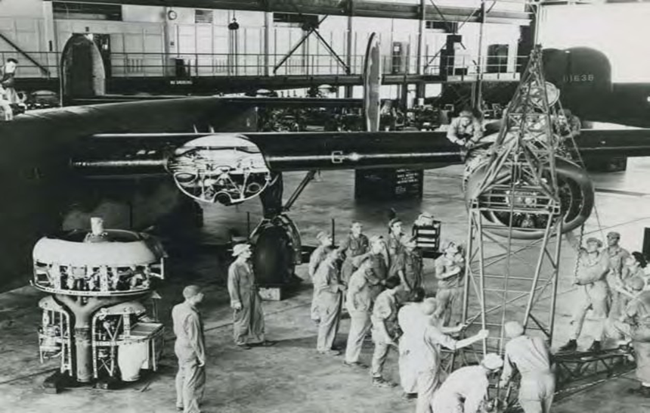
Keesler AFB History
Keesler’s Airplane and Engine Mechanics School taught students B-24 Maintenance until 1945
War Department activated Army Air Corps Station No. 8, Aviation Mechanics School in Biloxi 12 June 1941
Technical training school officers and staff arrived mid-July 1941 for Airplane and Engine Mechanics School
First shipment of basic training recruits arrived at Keesler Field 21 August 1941
Designated as Keesler Army Airfield 25 August 1941 in honor of Second Lieutenant Samuel Reeves Keesler, Jr.
Focused upon training B-24 Liberator heavy bombers mechanics mid-1942

Slide 6
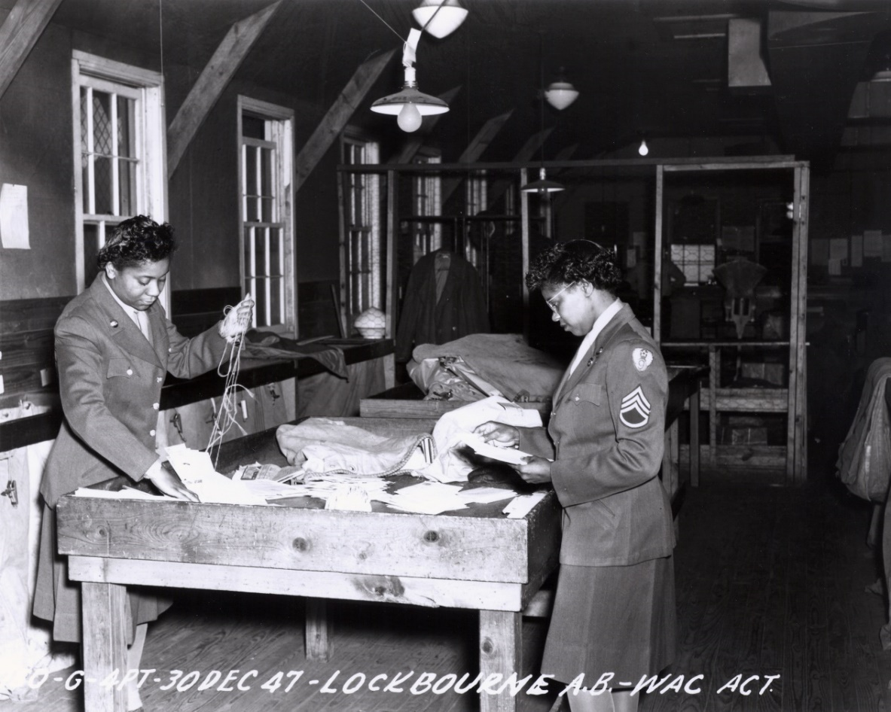
Keesler AFB History
Women's Army Auxiliary Corps (WAAC) in the Keesler mailroom
30 December 1947
Women's Army Auxiliary Corps (WAAC) activated 10 May 1943
Women and International Students entered technical training in 1943
More than 50 countries sent students to Keesler for aviation, personnel and electronics courses

Slide 7
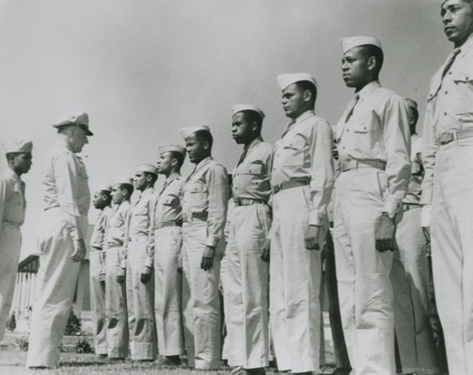
Keesler AFB History
Keesler’s first graduating class of African-American airplane mechanics, 1944
They were Tuskegee Airmen
More than 7,000 African-American Soldiers at Keesler by fall of 1943
U.S. Air Force established 18 September 1947
Radar School stood up 14 November 1947
Keesler Field officially redesignated as an Air Force base 13 January 1948
Airplane and Engine Mechanics School and the Radar School consolidated 1 April 1948 due to budget cuts.
9 Air Force women participated in first Keesler co-educational technical course in Radio Operations School 15 June 1949
Last mechanics training courses moved to Sheppard AFB, Texas 9 November 1949

Slide 8
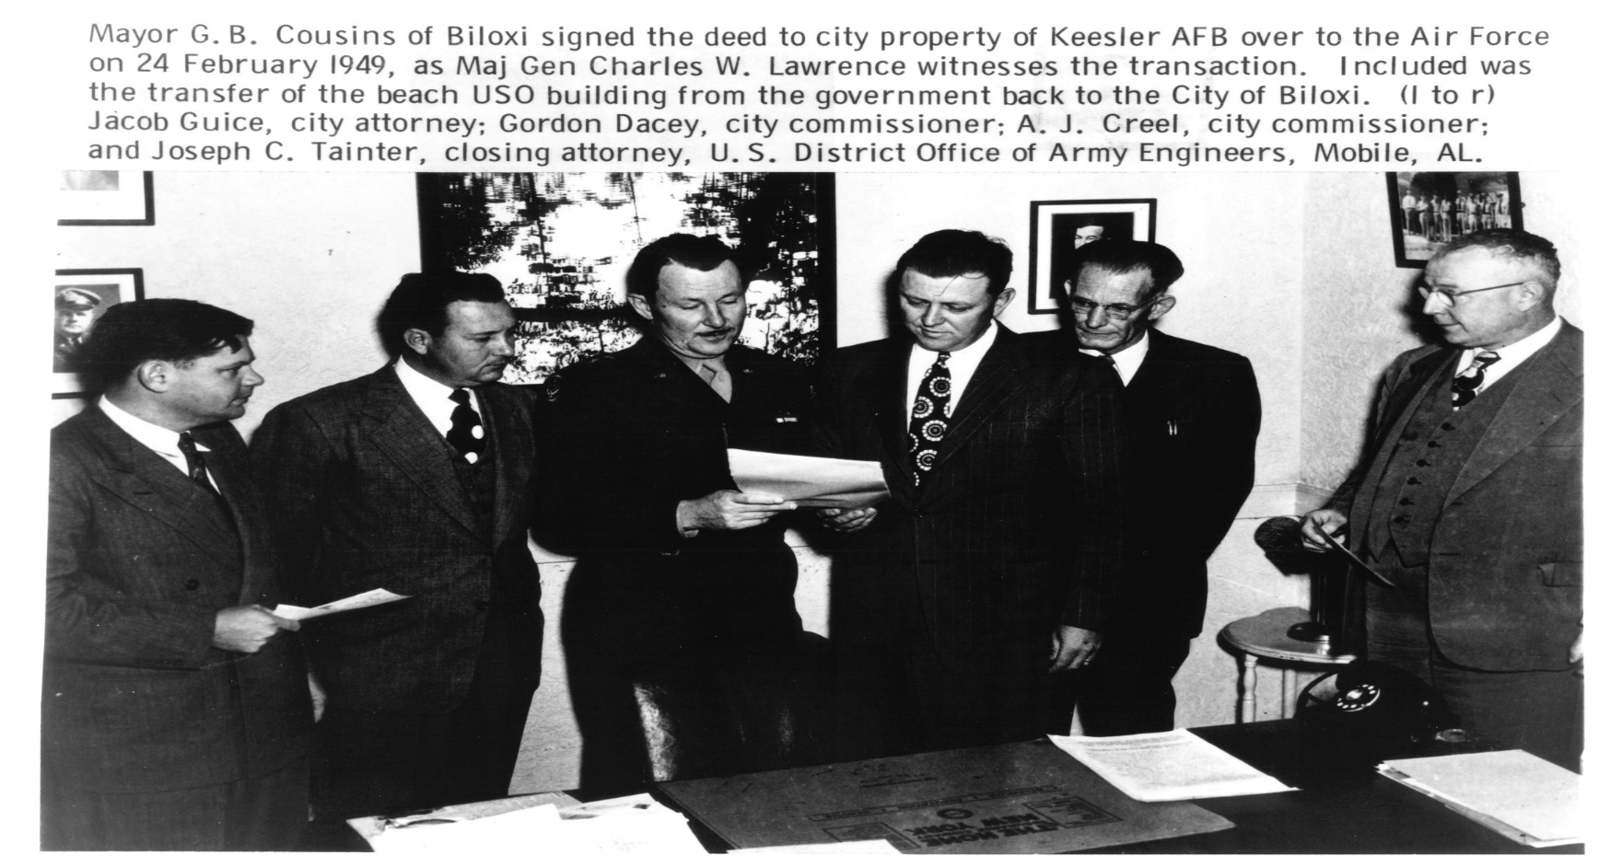
Keesler AFB History

Slide 9
Keesler AFB History
Tactical Air Command's Air-Ground Operations School arrived from Southern Pines, North Carolina. Its T-33s were the first jets assigned to Keesler 1 January 1959.
Air Training Command redesignated the 3380th Technical Training Wing as the Keesler Technical Training Center and the 3380th Technical Training Group became the 3380th Technical School, USAF. All student squadrons became school squadrons 20 May 1959.
The last C-47 left Keesler. These aircraft had been used for ground approach radar training, but the adoption of less expensive simulators made their use unnecessary 1 April 1965.
Hurricane Betsy lashed the Gulf Coast with winds over 100 miles per hour and storm surge as high as 15 feet above normal 9 September 1965. Downtown Biloxi suffered heavy flooding and wind damage. Keesler personnel assisted with rescue efforts, storm clean-up, and emergency repairs.
The command activated the 3389th Pilot Training Squadron at Keesler 15 January 1967. This unit trained foreign pilots under the Military Assistance Program (MAP) using the T-28 aircraft. Classes began on 23 January 1967.
Keesler’s student load peaked at 14,000 1 July 1969 during the Vietnam War.
Hurricane Camille made landfall at Waveland, Mississippi 18 August 1969, clocking wind gusts of over 200 miles per hour and pushing water surges as high as 35 feet above normal. More than 260 people were killed, and communities in five states were devastated. Keesler officials estimated on base damage at $3.5 million. During a subsequent inspection visit, President Richard Nixon praised the base's heroic rescue and community assistance efforts.

Slide 10
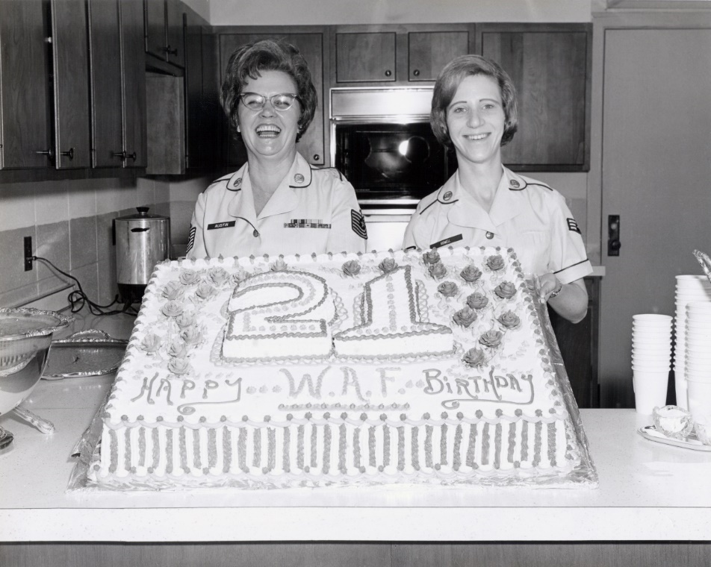
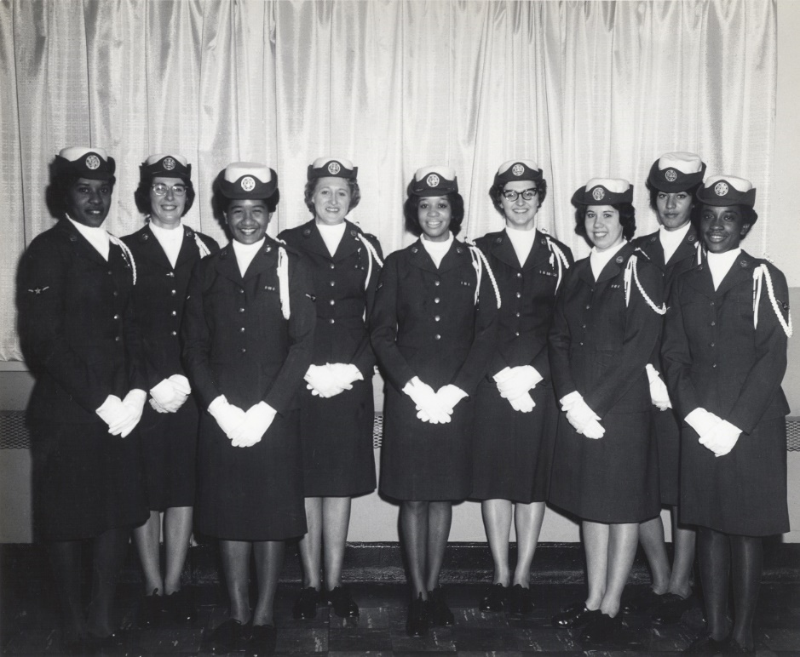
Keesler AFB History
Keesler celebrated the 21st Anniversary of the Women in the Air Force, circa 12 June 1971

Slide 11
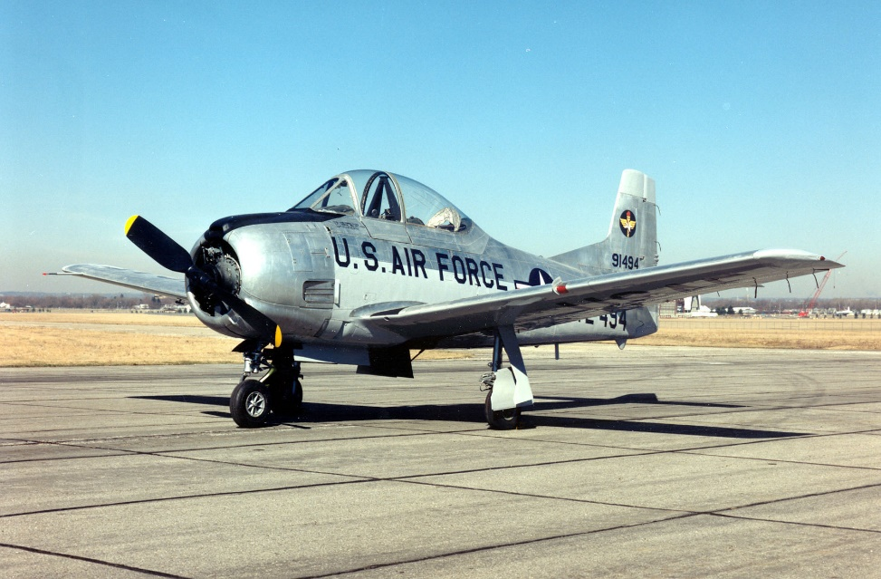
Keesler AFB History
Military Assistance Program (MAP) at Keesler Air Force Base
North American
T-28A Trojan (Courtesy of the National Museum of the United States Air Force)
3389th Pilot Training Squadron (PTS) activated at Keesler Air Force Base (KAFB) 15 January 1967.
The unit taught students from South Vietnam to fly the T-28 Trojan.
The KAFB student population peaked at over 14,000 on 1 July 1969.
3389th PTS instructed 743 MAP students from South Vietnam when ended its mission on 4 May 1973.

Slide 12
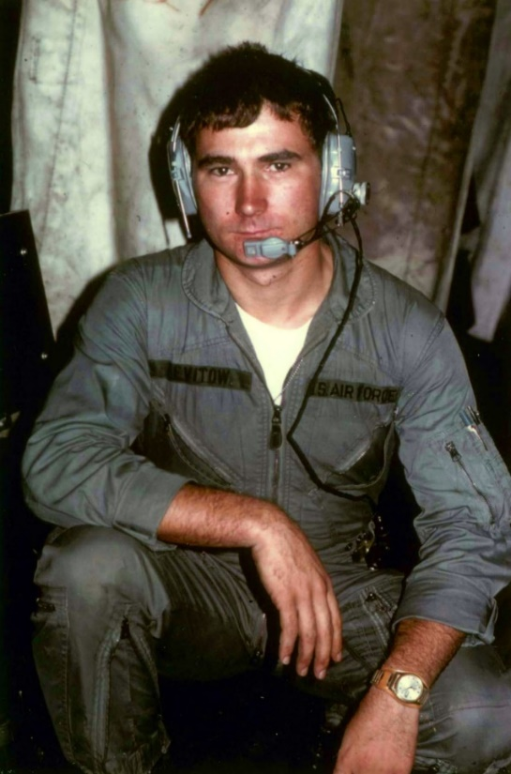
U.S. Air Force Vietnam War Hero
Airman First Class (A1C) John L. Levitow
(Courtesy of National Museum of the United States Air Force)
Loadmaster on AC-47 “Spooky 71” gunship night of 24 February 1969

Slide 13
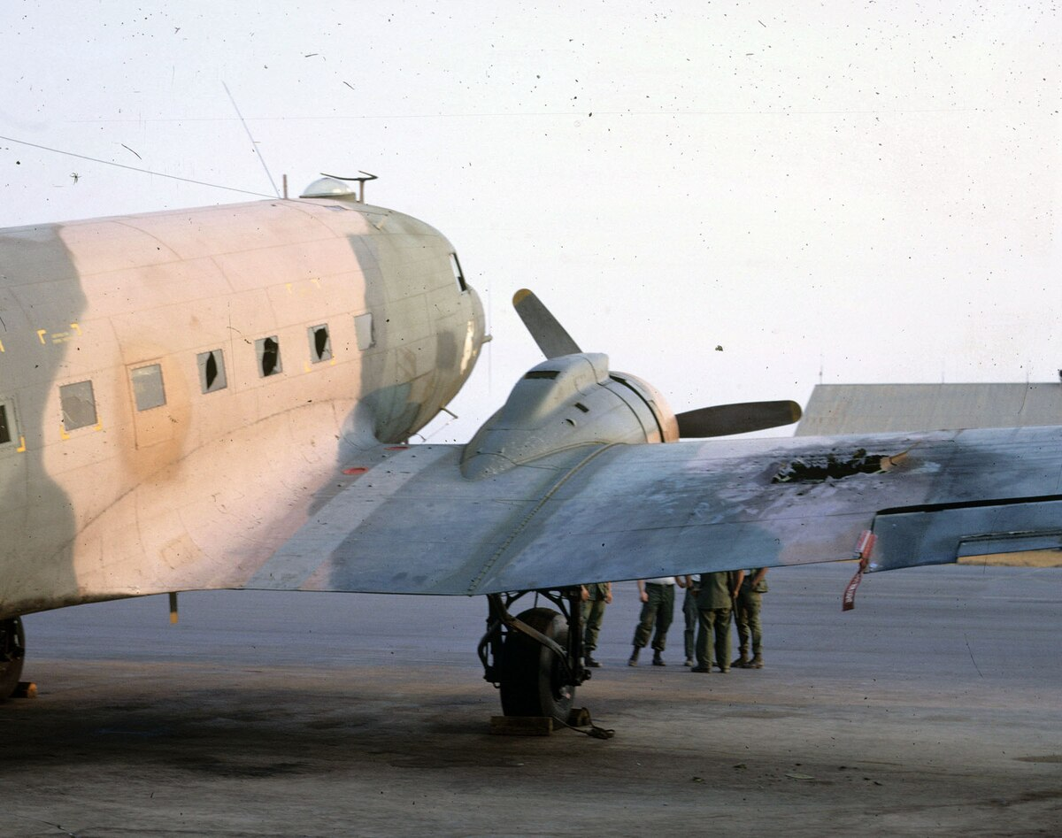
Spooky 71
Spooky 71 with damaged right wing (Courtesy of National Museum of the United States Air Force)
Enemy mortar damaged a wing of the aircraft and ignited 27-pound MK-24 flare.
A1C Levitow incurred in excess of 40 wounds, but dragged a crewman from open door.
A1C Levitow threw the smoking flare out of Spooky 71.

Slide 14
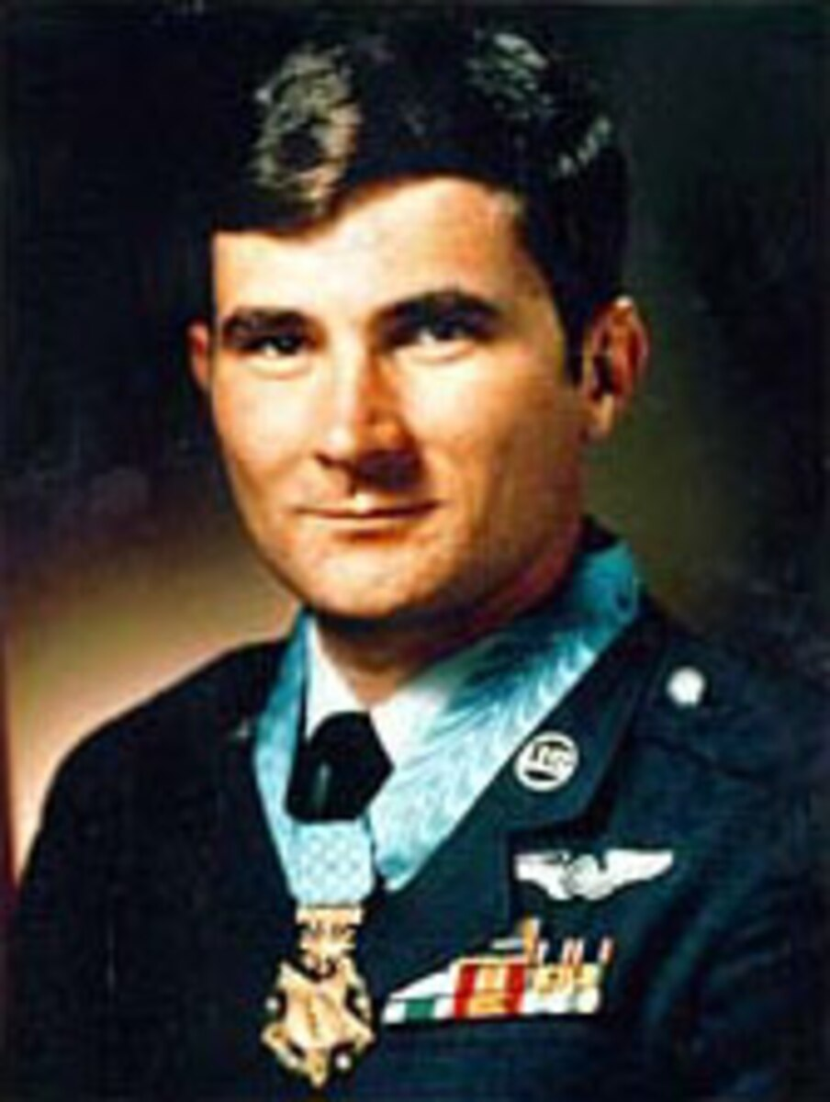
U.S. Air Force Vietnam War Hero
U.S. Air Force Sergeant
John L. Levitow
(Courtesy of National Museum of the United States Air Force)
A1C Levitow earned the Medal of Honor for saving a crew of seven and the aircraft.

Slide 15
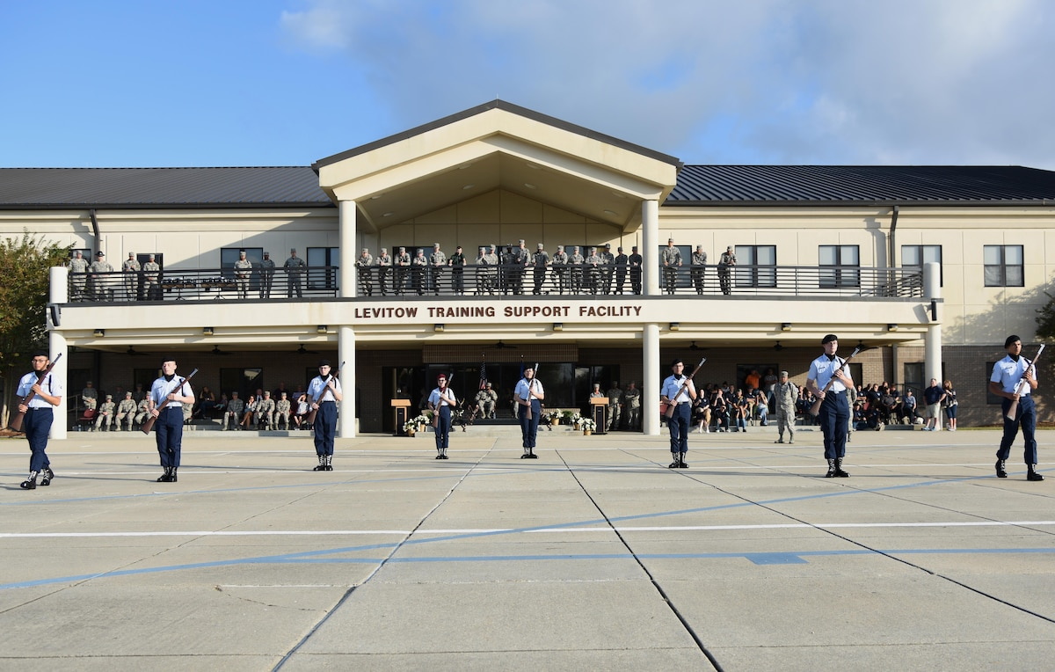
Levitow Training Support Facility
Building 7310 on KAFB is the Levitow Training Support Facility
It is a memorialization to Sergeant John L. Levitow
He passed away in the year 2000
(Air Force photo by Kemberly Groue)

Slide 16
Keesler AFB History
The Air Force Reserve activated the 920th Tactical Airlift Group at Keesler and equipped it with C-130s 25 April 1973.
The T-28 pilot training program ended 4 May 1973 after graduating 908 foreign students. The majority of them came from South Vietnam.
Keesler became the prime technical training center for the airborne warning and control system (AWACS) 21 December 1973.
Biloxi city officials obtained government approval for an access bridge 1 January 1976 which would connect Keesler with Interstate 110.
Hurricane Frederick struck 13 September 1979, causing about $11 million in property damage on the base. In addition to base clean up, many Air Force personnel assisted with recovery efforts in several communities along the Gulf Coast.
Base officials dedicated a new control tower 4 April 1980. It replaced a tower that had been in use since 1941.
As a result of the Professional Air Traffic Controllers Organization strike, the 3300th Technical Training Wing had to increase its production of air traffic controllers 1 August 1981.
Keesler Air Force Base hosted the first Special Olympics 24 April 1982. 350 competitors participated.
Over 260 Keesler medical personnel deployed to various locations in support of Operation Desert Storm 22 January 1991.
Military Airlift Command inactivated the 53d Weather Reconnaissance Squadron 30 June 1991. The 53d's hurricane hunter mission transferred to the 403d Airlift Wing, Keesler’s Air Force Reserve unit.

Slide 17
Keesler AFB History
Major Changes at Keesler Air Force Base on 1 July 1993
HQ USAF redesignated Air Training Command (ATC), headquartered at Randolph AFB, Texas, as Air Education and Training Command (AETC).
HQ AETC activated Second Air Force at Keesler and made the Numbered Air Force responsible for all technical training in the command. The command inactivated Keesler Training Center and all of its subordinate organizations, with the exception of the 393d Technical Training Group, which was redesignated as the 81st Technical Training Group.
HQ AETC activated the 81st Training Wing and assigned it to Second Air Force. The wing assumed the old center mission. Major components of the wing included the 81st Technical Training, 81st Support, 81st Logistics, and 81st Medical Groups.
HQ Keesler Medical Center inactivated, and HQ AETC activated the 81st Medical Group to operate the base hospital, which was still known as Keesler Medical Center.
The First Sergeants Academy moved to Maxwell AFB, Alabama. At the same time, HQ AETC reassigned the academy to Air University.

Slide 18
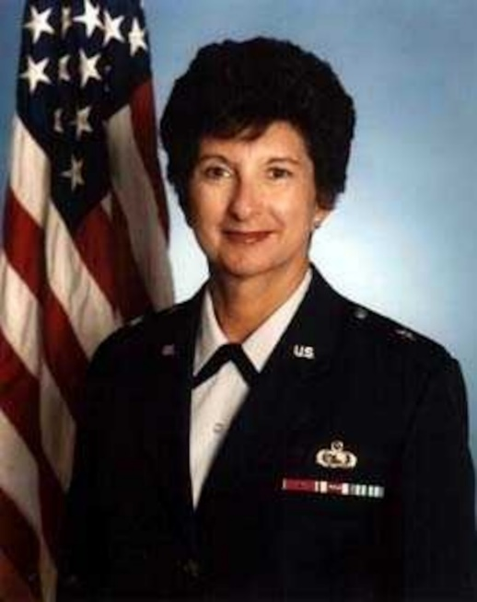
Keesler AFB History
Brigadier General Karen S. Rankin served as the first 81st Training Wing Commander when the unit activated at Keesler Air Force Base on 1 July 1993.

Slide 19
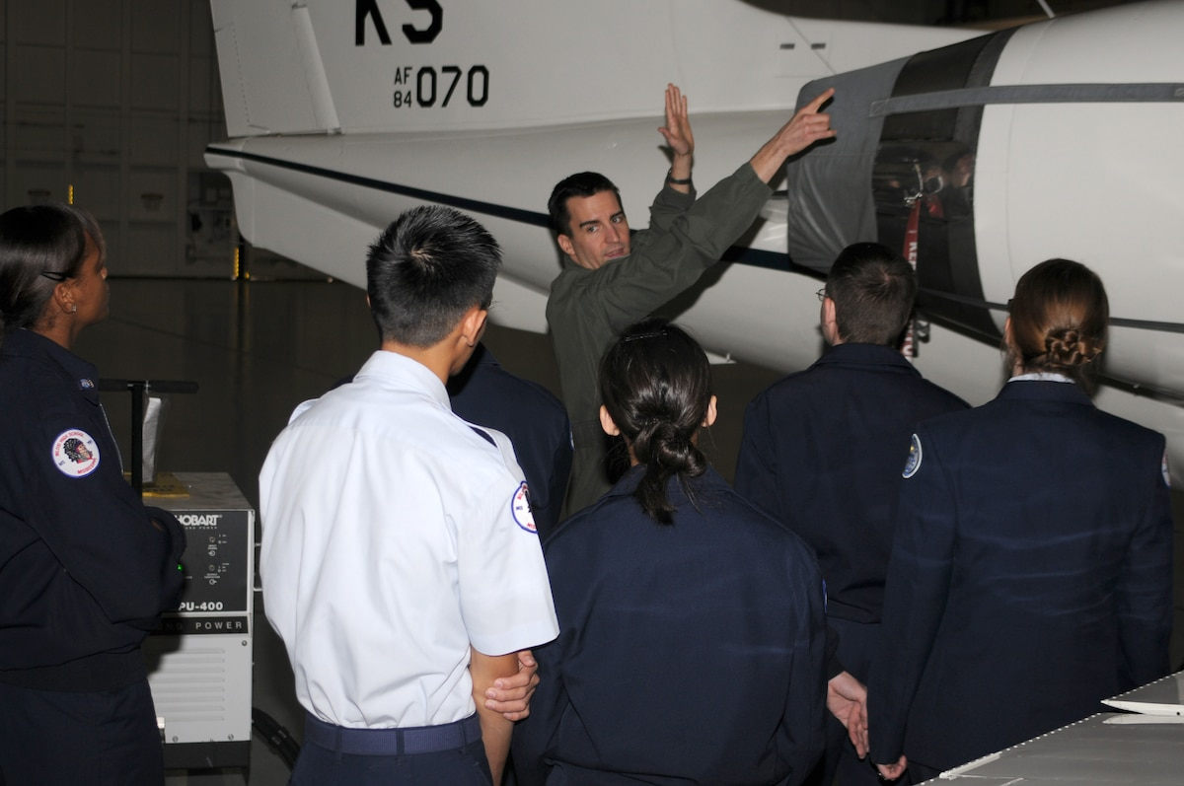
Keesler AFB History
The 45th Airlift Squadron activated and assigned to the 81st Training Group 1 July 1994. Equipped with C-12C/F Huron and C-21A Learjet aircraft, it brought flying training back to Keesler for the first time since 1973.
Captain Dave Cash, 45th Airlift Squadron, gave Junior ROTC cadets from Biloxi High School a walk around tour of a C-21 aircraft 14 January 2008.

Slide 20
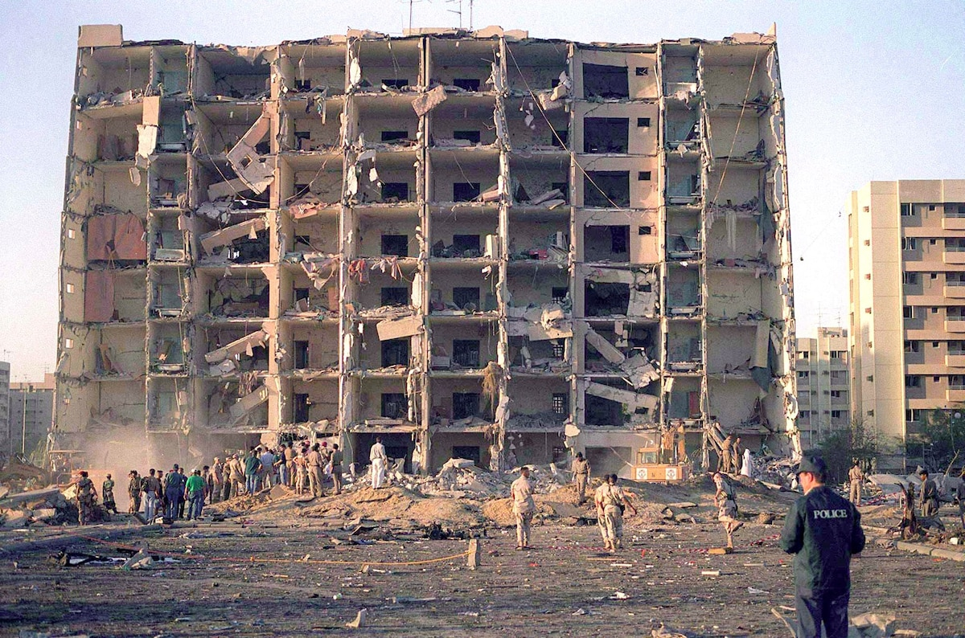
Keesler AFB History
Terrorists detonated a massive car bomb near the Khobar towers in Dhahran, Saudi Arabia 25 June 1995. Eleven Keesler personnel were deployed to the Air Base. They included Staff Sergeant Rondal Burns of the 333 TRS who was seriously injured and subsequently awarded the Purple Heart. Furthermore, SrA Martie Capoeman of the Wing’s Public Affairs office received an Air Force Achievement Medal with ‘V’ (for valor) device for her performance in providing emergency medical care.
On the night of 25 June 1996, a bomb detonated near the Khobar Tower housing complex. The blast killed 19 Airmen and injured in excess of 400 U.S. and international military members and civilians. (U.S. Air Force courtesy photo)

Slide 21
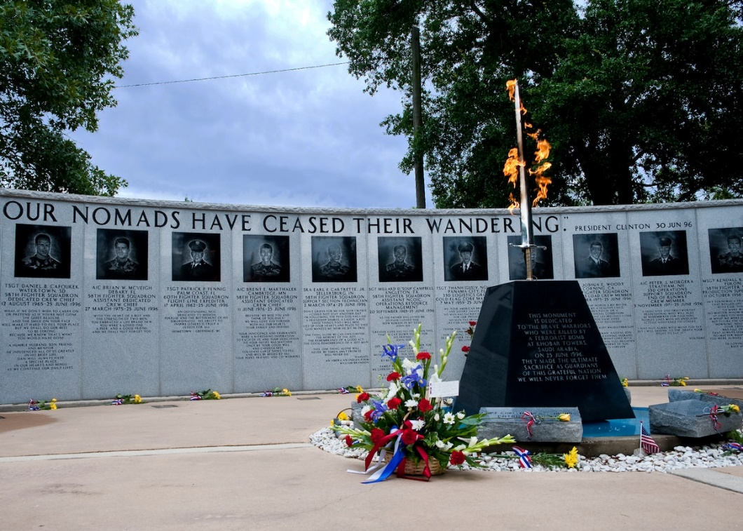
Keesler AFB History
The Khobar Towers Eternal Flame Monument and Memorial wall, at Eglin Air Force Base, FL, were dedicated one year after the Khobar Towers bombing on 25 June 1996. (U.S. Air Force photo /Samuel King Jr.)

Slide 22
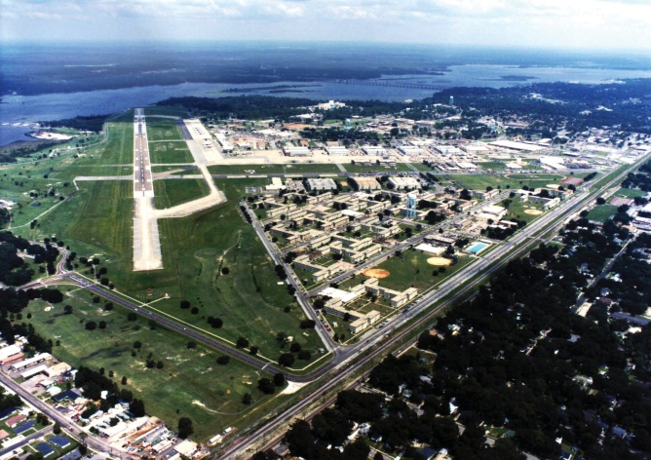
Keesler AFB History
Lieutenant General John C. Griffith, AETC Vice-Commander, led an official party in breaking ground for the first construction phase of Triangle Vision 24 February 1997.
The 403d Wing, Keesler’s Reserve tenant unit, received the first of the new C-130J trainer aircraft 17 February 1999. The “J” model aircraft replaces the 1960s era aircraft, lowering operating costs and enhancing performance and capabilities of the unit’s weather reconnaissance mission.
Keesler AFB’s premier “Triangle Vision.”

Slide 23
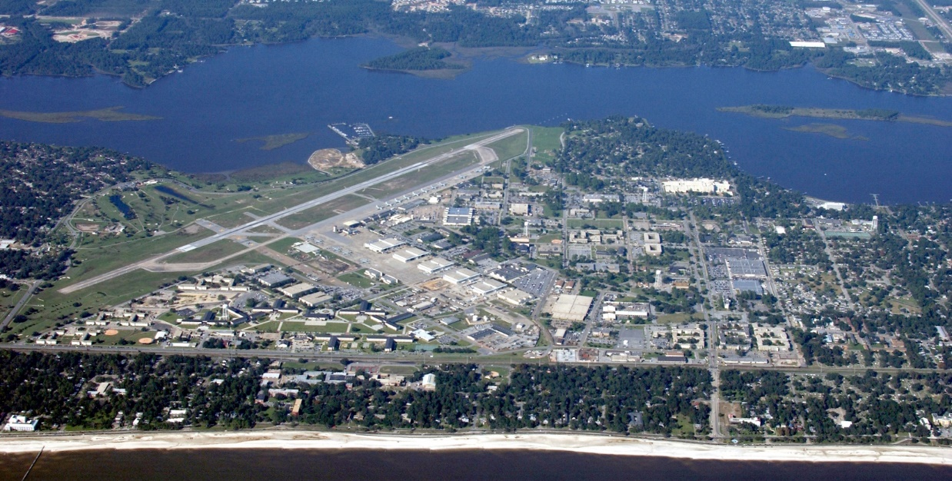
Keesler AFB History
Aerial photograph of modern day Keesler Air Force Base
Hurricane Katrina struck KAFB and surrounding Gulf Coast Communities 29 August 2005 causing almost a billion dollars in damage to KAFB.
KAFB promptly resumed technical training 20 October 2005 by executing Operation DRAGON COMEBACK.
The first officers graduated from the Undergraduate Cyber Training (UCT) program 7 December 2010.

Slide 24
Keesler AFB History
Base leaders, community partners, and Biloxi elected representatives gathered at the Biloxi Visitors Center on 3 June 2016 to celebrate Biloxi/Keesler Partnership Day. The evening event highlighted Keesler’s partnership with the City of Biloxi through a city proclamation read by the city’s Mayor, Andrew Gilich and a Keesler historical display featuring Keesler’s 75 years on the Gulf Coast.
Airmen of the 81 Medical Operations Squadron carried out the first Micra Transcatheter Pacing System for patient insertion procedure in the Air Force 13 April 2017. They implanted the smallest pacemaker in the world for patients with bradycardia at Keesler Medical Center. The device is approximately the size of a vitamin and it weighs the same as a penny.
KAFB, Biloxi, and State of Mississippi leaders announced a 37 million dollar Division Street new main gate construction project during a ceremony at KAFB 1 June 2017. The event highlighted the Air Force Community Partnership Program that KAFB started on 3 May 2017.
The Air Education and Training Command (AETC) recognized the 81 Training Wing (81 TRW) with 2017 Innovation Challenge Mission Accomplishment award 19 March 2018. Additionally, the 81 TRW earned a monetary award the unit may spend for any operations and maintenance fund purchases. The 81 TRW received this honor during the AETC Senior Leadership Conference at Vandenberg Air Force Base, CA. The event occurred 19 through 21 March 2018.
Community Milestones

Slide 25
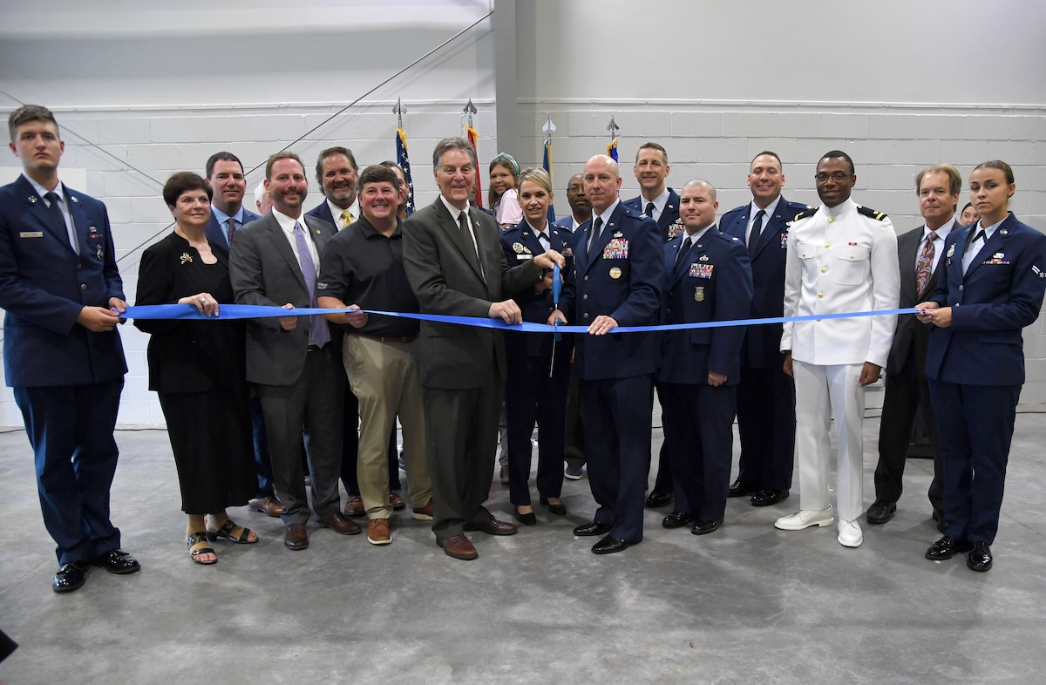

Keesler AFB History
Community Milestones
Colonel William Hunter, 81 TRW/CC, and Biloxi Mayor, Andrew “FoFo” Gilich, slashed the ribbon during the Division Street Gate Ribbon Cutting Ceremony 26 May 2022. Additionally, Major General Michele Edmondson, 2nd AF/CC, took part in the ribbon cutting. Furthermore, Colonel Hunter provided remarks. Brigadier General Thomas Harrell, (AFMRA/CC), U.S. Representative Steven Palazzo, and several other distinguished visitors also attended the ceremony. The new Visitor Control Center (VCC) opened at the Division Street Gate 15 August 2022.
Division Street Gate Ribbon Cutting Ceremony on 26 May 2022. (U.S. Air Force Photo by Kemberly Groue

Slide 26
Keesler AFB History
Colonel Heather Blackwell, 81 TRW/CC, issued a Special Commander’s Alert 15 March 2020 regarding access to the Keesler Medical Center (KMC) in response to the spread of the COVID-19 virus.
The order directed KMC staff and patients to enter the KMC only through the main entrance or the Emergency Room effective 16 March 2020. Furthermore, no individuals under the age of 18 and no individuals with a cough, fever, or cold could visit inpatients effective 16 March 2020.
Only patients with appointments could visit the outpatient clinics at the KMC effective 16 March 2020.
Colonel Heather Blackwell, 81 TRW/CC, heralded the availability of the COVID-19 vaccinations 17 May 2021 to all beneficiaries at the Keesler Medical Center (KMC).
Colonel William Hunter, 81TRW/CC, emphasized to the KAFB community after he took command of KAFB on 17 June 2021 that we must co-exist with the public health threat from COVID-19. He routinely directed KAFB to maintain COVID-19 mitigation protocols.
COVID-19 Pandemic

Slide 27
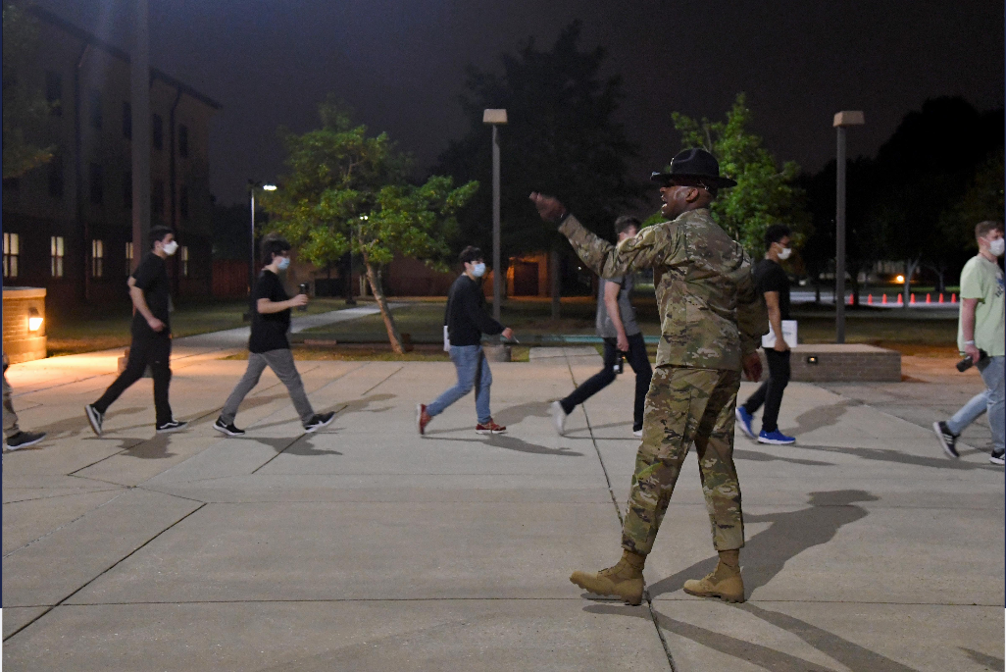
Keesler AFB History
Detachment 5 of the 737th Training Group (737th TRG) received 58 recruits at KAFB on 7 and 8 April 2020. This action started the Keesler BMT Proof of Concept. The recruits incurred a 14-day Restriction of Movement (ROM) at the start of their training. The KAFB BMT allowed Lackland Air Force Base, Texas to disperse recruits from that centralized Air Force BMT location as a COVID-19 mitigation measure. The KAFB recruits trained for six weeks.
COVID-19 Pandemic: Keesler Basic Military Training (BMT) Proof of Concept
U.S. Air Force Tech. Sgt. RaShawn Duffy, 37th Training Wing Detachment 5 military training instructor, delivers instruction to trainees outside Erwin Manor at Keesler Air Force Base, Mississippi, April 7, 2020. Keesler was the newest training site for 58 incoming basic military training Airmen. With proactive planning and protective measures already in place in response to the COVID-19 pandemic, Keesler hosted the 37th TRW Detachment 5 to better protect the health and safety of the trainees and military training instructors while also providing relief to Lackland Air Force Base's training infrastructure. (U.S. Air Force photo by Kemberly Groue)

Slide 28
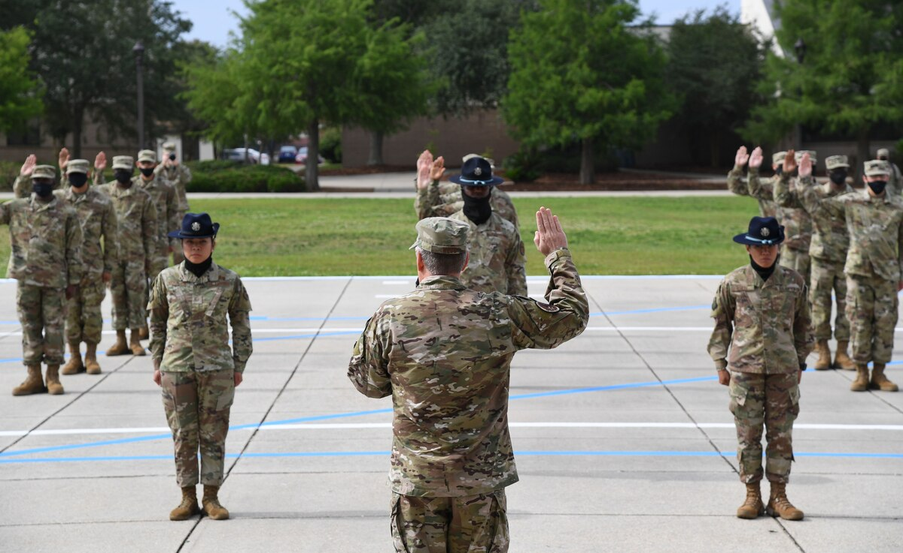
Keesler AFB History
COVID-19 Pandemic: Keesler Basic Military Training (BMT) Proof of Concept
KAFB BMT ended when DET. 5 of the 737 TRG graduated its 939th Airman on 6 November 2020.
U.S. Air Force Lt. Gen. Brad Webb, commander of Air Education and Training Command, delivers the Oath of Enlistment during the basic military training graduation ceremony at Keesler Air Force Base, Mississippi, May 15, 2020. Fifty-eight Airmen from the 37th Training Wing Detachment 5 completed the six-week basic military training course. This was the first time since 1968 that Airmen graduated from U.S. Air Force basic military training outside of Lackland Air Force Base, Texas. (U.S. Air Force photo by Kemberly Groue) 19rmen gr

Slide 29
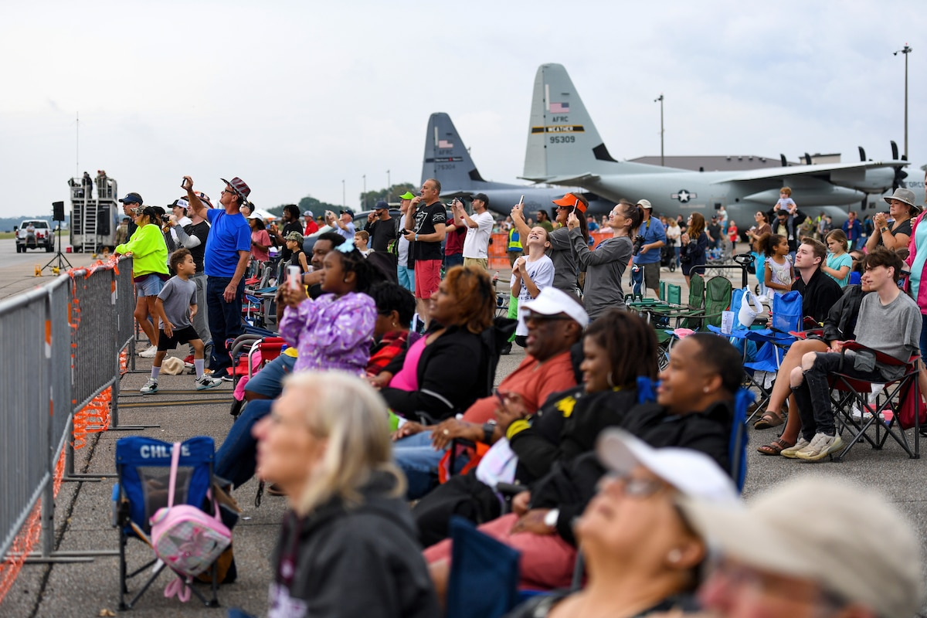
Keesler AFB History
Thunder Over the Sound Air and Space Show 29 -30 April 2023
Spectators gather for the 2023 Thunder Over the Sound Air and Space Show at Keesler Air Force Base, Mississippi, April 29, 2023. Thunder Over the Sound is a unique event where a military installation and its surrounding city jointly host an air show in two locations; Biloxi Beach and Keesler Air Force Base's flightline. (U.S. Air Force photo by Kemberly Groue)

Slide 30
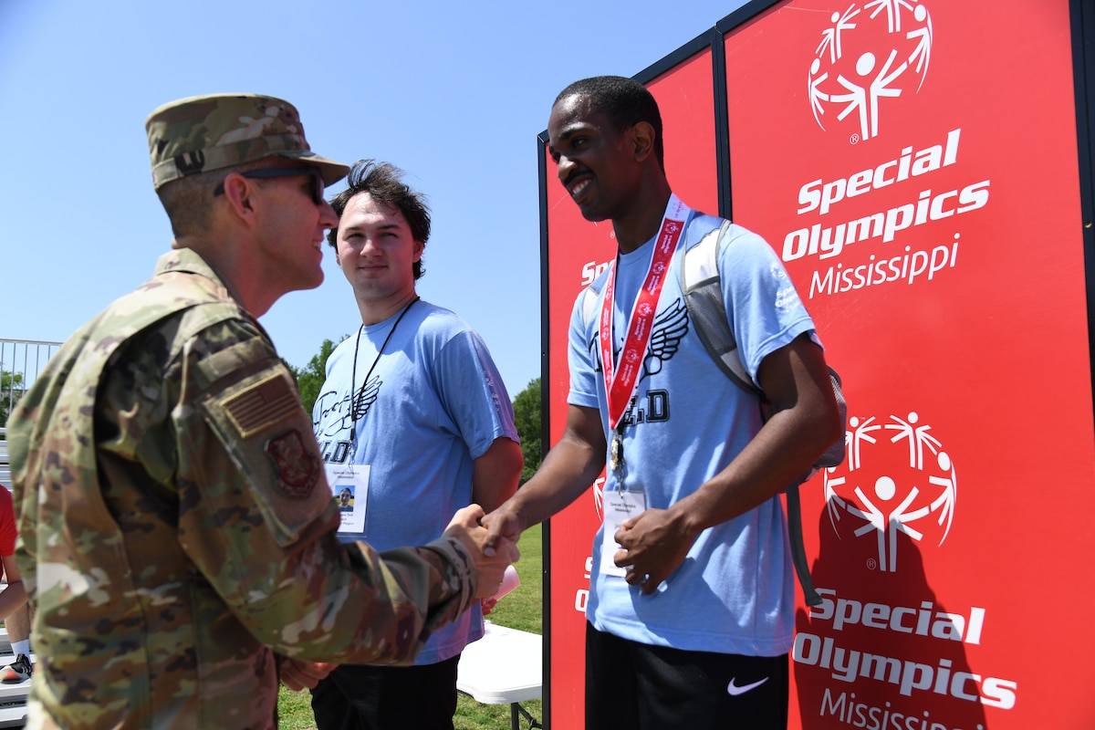
Keesler AFB History
35th Special Olympics Mississippi 12 -13 May 2023
Special Olympics Mississippi athletes receive medals from Colonel Billy E. Pope, Jr., 81st TRW/CC, during the SOMS Summer Games at Keesler Air Force Base, Mississippi, May 13, 2023. Over 500 athletes participated in the Summer Games. (U.S. Air Force photo by Kemberly Groue)

Slide 31
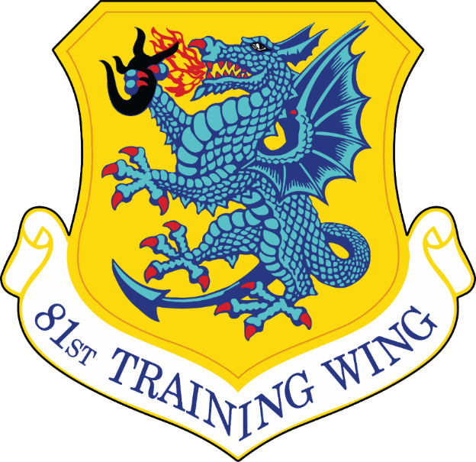
Notes:
Be Focused
Be Driven
Be Warriors

